Slide 1
Java Collections
Day 8

Slide 2
Objectives
Garbage Collection
Discussion on Java Collections
  Map
  Iterator
  Stacks
  Queues
  Hash Map
  Array List

Slide 3
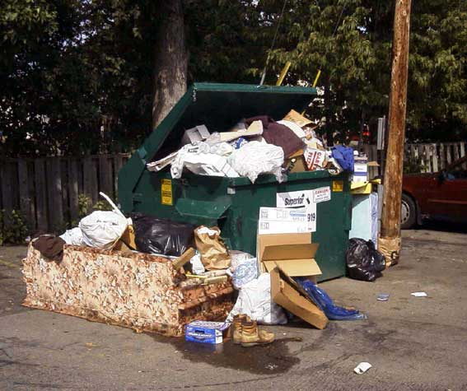
Garbage collection
You can write your own garbage collection.
There is no way to ‘force’ a garbage collection event happen.
Calling the gc method will only ‘suggests’ the garbage collection event to happen.

Slide 4
Garbage Collection
Sometimes called Automatic Memory Management (OO)
Affects design of programs
  Tendency to use painless features
  Does have cost
Part of overall heap management problem
Not the only solution
Two flavors
  Constant sized allocation units
  Variable sized allocation units

Slide 5
What is Garbage Collection?
Program(mer) requests allocation of memory from heap.
If allocation is granted, memory is allocated and address is returned and stored in pointer variable.
Contents of pointer variable may be copied so that multiple pointers may exist pointing to same location
The allocated area becomes "garbage" if it is no longer being referenced by any pointer.
Typically garbage collection occurs when the runtime system no longer has any free memory to allocate

Slide 6
Collections
A collection (sometimes called a container) is an object that groups multiple elements into a single unit.
Collections are used to store, retrieve and manipulate data, and to transmit data from one method to another.
Collections typically represent data items that form a natural group, a card hand, a mail folder, a telephone directory…

Slide 7
The Java Collections Framework
The Java collections framework is made up of a set of interfaces and classes for working with groups of objects
The Java Collections Framework provides
  Interfaces: abstract data types representing collections.
  Implementations: concrete implementations of the collection interfaces.
  Algorithms: methods that perform useful computations, like searching and sorting, on objects that implement collection interfaces.

Slide 8
The Java Collections Framework
The Java collections framework is made up of a set of interfaces and classes for working with groups of objects
The Java Collections Framework provides
  Interfaces: abstract data types representing collections.
  Implementations: concrete implementations of the collection interfaces.
  Algorithms: methods that perform useful computations, like searching and sorting, on objects that implement collection interfaces.

Slide 9
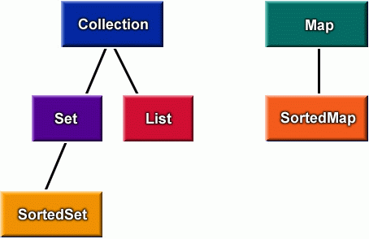
The Interfaces

Slide 10
Sets
A group of unique items, meaning that the group contains no duplicates
Some examples
  The set of uppercase letters ‘A’ through ‘Z’
  The set of non-negative integers { 0, 1, 2, … }
  The empty set {}
  The students in this class
The basic properties of sets
  Contain only one instance of each item
  May be finite or infinite
  Can define abstract concepts

Slide 11
Lists
Elements in a list are ordered
  By insertion sequence, if nothing else
  By magnitude, alphabetical order, etc.
A list can contain duplicate entries
  e.g., a list of purchased items can include the same item more than once.

Slide 12
Maps
A map is a set of pairs
  each pair represents a one-directional “mapping” from one object (the key) to another (the value)
The typical use of a Map is to provide access to values stored by key
Some examples
  A map of student IDs to database records
  A dictionary (words mapped to meanings)
  The conversion from base 2 to base 10
  Names to phone numbers

Slide 13
Collections, Maps…
What Is The Real Difference?
Collections
  You can add, remove, lookup isolated items in the collection
Maps
  The collection operations are available but they work with a key-value pair instead of an isolated element

Slide 14
Another Way to Look At It
The Collection interface is a group of objects, with duplicates allowed
Set extends Collection but forbids duplicates
List extends Collection and allows duplicates and positional indexing
Map extends neither Set nor List nor Collection

Slide 15
The Collection Interface
Found in the java.util
package
Collection
// Basic Operations
size():int;
isEmpty():boolean;
contains(Object):boolean;
add(Object):boolean; // Optional
remove(Object):boolean; // Optional
iterator():Iterator;
// Bulk Operations
containsAll(Collection):boolean;
addAll(Collection):boolean; // Optional
removeAll(Collection):boolean; // Optional
retainAll(Collecton):boolean; // Optional
clear():void; // Optional
// Array Operations
toArray():Object[];
toArray(Object[]):Object[];
Optional methods throw
UnsupportedOperationException
if the implementing class does
not support the operation.
Bulk operations perform
some operation on an entire
Collection in a single shot
The toArray methods allow the contents
of a Collection to be translated into
An array.

Slide 16
Set Interface
A Set is a Collection that cannot contain duplicate elements.
  Set models the mathematical set abstraction.
The Set interface extends Collection and contains no methods other than those inherited from Collection
It adds the restriction that duplicate elements are prohibited.
Two Set objects are equal if they contain the same elements.

Slide 17
Set Bulk Operations
The bulk operations perform standard set-algebraic operations. Suppose s1 and s2 are Sets.
  s1.containsAll(s2): Returns true if s2 is a subset of s1.
  s1.addAll(s2): Transforms s1 into the union of s1 and s2. (The union of two sets is the set containing all the elements contained in either set.)
  s1.retainAll(s2): Transforms s1 into the intersection of s1 and s2.
    (The intersection of two sets is the set containing only the elements that are common in both sets.)

Slide 18
Java Lists
A List is an ordered Collection (sometimes called a sequence).
Lists may contain duplicate elements.
In addition to the operations inherited from Collection, the List interface includes operations for:
  Positional Access
  Search
  List Iteration
  Range-view

Slide 19
Java Maps
Accessing Map elements is different from accessing List and Set elements, so the methods are different.
  Map does not inherit from Collection
Map interface provides for storing and accessing both key and value objects

Slide 20
Iterator
An object that implements the Iterator interface generates a series of elements, one at a time
  Successive calls to the next() method return successive elements of the series.
The remove() method removes from the underlying Collection the last element that was returned by next().
Iterator
hasNext():boolean;
next():Object;
remove():void;

Slide 21
ListIterator
The ListIterator interface extends Iterator
  Forward and reverse directions are possible
ListIterator is available for Java Lists, particularly the LinkedList implementation
ListIterator
hasNext():boolean;
next():Object;
hasPrevious():boolean;
previous(): Object;
nextIndex(): int;
previousIndex(): int;
remove():void;
set(Object o): void;
add(Object o): void;

Slide 22
Implementation Classes
Interface | Implementation |  |  |  | Historical
Set | HashSet |  | TreeSet
List |  | ArrayList |  | LinkedList | Vector Stack
Map | HashMap |  | TreeMap |  | HashTable Properties

Slide 23
Choosing an Implementation
Fast random access by key:
Access data by key with frequent need to traverse the set of keys in order:
No duplicates allowed; fast access to individual objects:
Frequent need to report sorted individual data elements:
Duplicates allowed; need to access data by position; new elements usually added to the end:
Duplicates allowed; usual need is to traverse the collection in order.
Thread-Safety
Vector and Hashtable methods are synchronized to provide Thread –Safety

Slide 24
What About User Objects?
The Collections framework will work with any Java class
You need to be sure you have defined
  equals()
  hashCode()
  compareTo()
Don’t use mutable objects for keys in a Map

Slide 25
Interface and class hierarchy for Collections
Collection (I/F)
Map (I/F)
Set (I/F)
List (I/F)
Queue (I/F)
SortedMap (I/F)
Sorted Set (I/F)
TreeMap
HashSet
LinkedHashSet
ArrayList
Vector
LinkedList
PriotityQueue
Hashtable
HashMap
LinkedHashMap
TreeSet
→ extends → implements I/F- Interface

Slide 26
Interface Comparable
This ordering is referred to as the class's natural ordering, and the class's compareTo() method is referred to as its natural comparison method.
A class's natural ordering is said to be consistent with equals if, and only if, (e1.compareTo((Object)e2)==0) has the same boolean value as: e1.equals((Object)e2)
  for every e1 and e2 of class C.

Slide 27
hashCode()
hashCode() returns distinct integers for distinct objects – used for determining location in a Map.
  If two objects are equal according to the equals() method, then the hashCode() method on each of the two objects must produce the same integer result.
  When hashCode() is invoked on the same object more than once, it must return the same integer (provided no information used in equals() comparisons has been modified).
  It is not required that if two objects are unequal according to equals()that hashCode() must return distinct integer values.

Slide 28
Comparator Interface
When a collection must be sorted in a different order than its “natural order,” you can provide an object implementing the Comparator Interface to do so.
  Sort people by age instead of name
  Sort cars by year instead of Make and Model
  Sort clients by city instead of name
  Sort words alphabetically regardless of case

Slide 29
Comparator Interface
One method:
  compare( Object o1, Object o2 )
Returns:
  negative if o1 < o2
  Zero if o1 == o2
  positive if o1 > o2

Slide 30
Summary
Garbage Collection
Discussion on Java Collections
  Map
  Iterator
  Stacks
  Queues
  Hash Map
  Array List

Slide 31
Java-Threads

Slide 32
Process
< - Life Cycle - >
Start-Run-Stop
Process
CPU
OS

Slide 33
Multi - Thread
CPU
Process 1
Data 1
CPU
Data 2
Process 2
Process 4
Data 4
Data 3
Process 3

Slide 34
Java Thread States
Non-Existing
create thread object
destroy
New
start
Ready
destroy
notify, notify All
thread termination
run method
exits
wait, join
Blocked
Dead
destroy
garbage collected
and finalization
Non-Existing

Slide 35
What are Threads?
Java-Threads
A piece of code that run in concurrent with other threads.
Each thread is a statically ordered sequence of instructions.
Threads are being extensively used express concurrency on both single and multiprocessors machines.
Programming a task having multiple threads of control – Multithreading or Multithreaded Programming.

Slide 36
Java Threads
Java-Threads Contd
Java has built in thread support for Multithreading
Synchronization
Thread Scheduling
Inter-Thread Communication:
  currentThread start setPriority
  yield run getPriority
  sleep stop suspend
  resume
Java Garbage Collector is a low-priority thread.

Slide 37
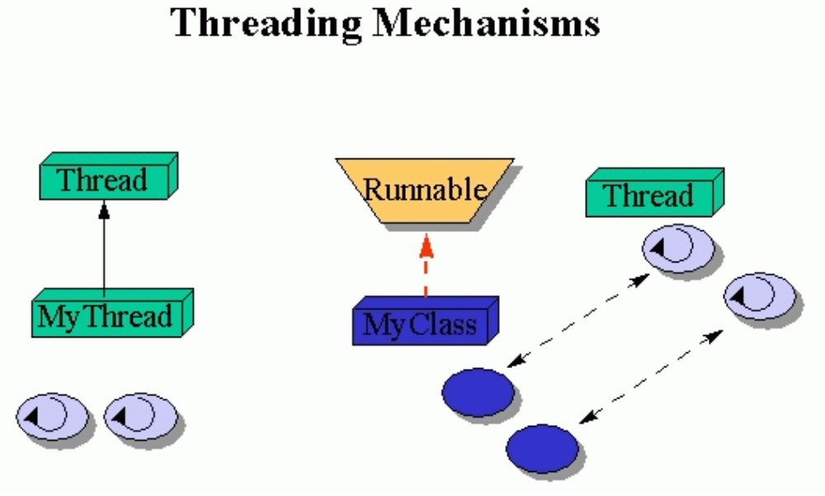
Threading Mechanisms...
Creating threads
Create a class that extends the Thread class
Create a class that implements the Runnable interface

Slide 38
1st method: Extending Thread class
Threads are implemented as objects that contains a method called run()
class MyThread extends Thread
{
public void run()
{
// thread body of execution
}
}
Create a thread:
MyThread thr1 = new MyThread();
Start Execution of threads:
thr1.start();
Create and Execute:
new MyThread().start();

Slide 39
Java-Threads
An Example
class MyThread extends Thread { // the thread
public void run() {
System.out.println(" this thread is running ... ");
}
} // end class MyThread
class ThreadEx1 { // a program that utilizes the thread
public static void main(String [] args ) {
MyThread t = new MyThread();
// due to extending the Thread class (above)
// I can call start(), and this will call
// run(). start() is a method in class Thread.
t.start();
} // end main()
} // end class ThreadEx1

Slide 40
2nd Method
2nd Method : Threads by implementing Runnable
class MyThread implements Runnable
{
.....
public void run()
{
// thread body of execution
}
}
Creating Object:
MyThread myObject = new MyThread();
Creating Thread Object:
Thread thr1 = new Thread( myObject );
Start Execution:
thr1.start();

Slide 41
An Example
class MyThread implements Runnable {
public void run() {
System.out.println(" this thread is running ... ");
}
} // end class MyThread
class ThreadEx2 {
public static void main(String [] args ) {
Thread t = new Thread(new MyThread());
// due to implementing the Runnable interface
// I can call start(), and this will call run().
t.start();
} // end main()
} // end class ThreadEx2

Slide 42
Thread types
Threads Types
Java threads types
User
Daemon
Provide general services
Typically never terminate
Call setDaemon() before start()
Program termination
If all non-daemon threads terminate, JVM shuts down

Slide 43
Threads Types
Thread Methods
Some of the Thread methods
public class Thread {
public String getName();
public boolean isAlive();
public void join();
public void setDaemon(boolean on);
public void setName(String name);
public void setPriority(int level);
public static Thread currentThread();
public static void sleep(long milliseconds);
public static void yield();
}

Slide 44
Accessing Shared Resources
Applications Access to Shared Resources need to be coordinated.
  Printer (two person jobs cannot be printed at the same time)
  Simultaneous operations on your bank account

Slide 45
Shared Resources
Java-Threads
If one thread tries to read the data and other thread tries to update the same date, it leads to inconsistent state.
This can be prevented by synchronising access to the data.
In Java: “Synchronized” method:
  public synchronized void update()
  {
    …
  }

Slide 46
Example
class InternetBankingSystem {
public static void main(String [] args ) {
Account accountObject = new Account ();
Thread t1 = new Thread(new MyThread(accountObject));
Thread t2 = new Thread(new YourThread(accountObject));
Thread t3 = new Thread(new HerThread(accountObject));
t1.start();
t2.start();
t3.start();
// DO some other operation
} // end main()
}

Slide 47
class MyThread implements Runnable {
Account account;
public MyThread (Account s) { account = s;}
public void run() { account.deposit(); }
} // end class MyThread
class YourThread implements Runnable {
Account account;
public YourThread (Account s) { account = s;}
public void run() { account.withdraw(); }
} // end class YourThread
class HerThread implements Runnable {
Account account;
public HerThread (Account s) { account = s; }
public void run() {account.enquire(); }
} // end class HerThread
Shared Account between Objects
account (
Shared Object)

Slide 48
Synchronization
class Account { // the 'monitor'
int balance;
// if 'synchronized' is removed, the outcome is unpredictable
public synchronized void deposit( ) {
// METHOD BODY : balance += deposit_amount;
}
public synchronized void withdraw( ) {
// METHOD BODY: balance -= deposit_amount;
}
public synchronized void enquire( ) {
// METHOD BODY: display balance.
}
}

Slide 49
Synchronized Threads
synchronized methods prevent more than one thread from accessing an object's critical method code simultaneously.
You can use the synchronized keyword as a method modifier, or to start a synchronized block of code.
To synchronize a block of code (in other words, a scope smaller than the
whole method), you must specify an argument that is the object whose lock you want to synchronize on.
While only one thread can be accessing synchronized code of a particular instance, multiple threads can still access the same object's unsynchronized code.
When a thread goes to sleep, its locks will be unavailable to other threads.
Static methods can be synchronized, using the lock from the java.lang.Class instance representing that class.

Slide 50
Inter Process –Communications
Threads can communicate with each other through these three methods
wait()
notify()
notifyAll()
The wait() method lets a thread say, "there's nothing for me to do now, so
put me in your waiting pool and notify me when something happens that I
care about." Basically, a wait() call means "wait me in your pool," or "add
me to your waiting list."

Slide 51
notify() and notifyAll()
The notify() method is used to send a signal to one and only one of the threads that are waiting in that same object's waiting pool.
The notify() method can NOT specify which waiting thread to notify.
The method notifyAll() works in the same way as notify(), only it sends the signal to all of the threads waiting on the object.
All three methods—wait(), notify(), and notifyAll()—must be
called from within a synchronized context! A thread invokes wait() or notify() on a particular object, and the thread must currently hold the lock on that object.

Slide 52
Deadlock
Deadlocking can occur when a locked object attempts to access another locked object that is trying to access the first locked object. In other words, both threads are waiting for each other's locks to be released; therefore, the locks will never be released!

Slide 53
Summary
Creation of Threads
Methods in Threads
Types of Threads
Synchronization

